Slide 1
A FRAMEWORK TO EVALUATE MARINE RESERVES IN MEXICO
Caio Faro, Jael Martinez, Juan Carlos Villasenor and Melaina Wright
TURFeffect
Fall Review Meeting
November 03, 2016

Slide 2
Objectives
1. Determine a set of biophysical, socioeconomic and governance indicators that can be used to evaluate the effectiveness of no-take marine reserves in Mexico. 2. Use the selected indicators to propose a framework for evaluating the effectiveness of no-take marine reserves in Mexico. 3. Develop an English/Spanish guidebook with the selected indicators that walks the user through implementing our framework.

Slide 3
Upcoming Academic Deliverables
Academic defense
Final report
Project brief and poster
Public presentation

Slide 4
Summer and Fall Progress
Data Collection
Indicators and Reserves Objectives
Survey
Data Analysis
Outreach and Feedback

Slide 5
Summer and Fall Progress
Data Collection
Started during Spring quarter and continued over the summer
Jael and the ETJ
Indicators and Reserves’ Objectives
Redefined indicators
Matched indicators with objectives

Slide 6
Tipo | Objetivos | Biophysical |  |  |  |  |  | Socio-economical |  |  | Governance
 |  | Diversity index (Richness, Shannon, Simpson) | Density of mature organisms | Density * | Natural Disturbance | Trophic level | Biomass * | Landings | Income from landings | Alternative economic opportunities | Access to the fishery | Number of fishers | Legal recognition of reserve | Reserve type | Illegal harvesting | Management plan | Reserve enforcement | Size of reserve | Reasoning for reserve location | Membership to fisher organizations | Type of fisher organizations | Representation
ZRP | Recuperar especies de interés comercial |  | * | * | * |  | *
 | Conservar especies en régimen de protección especial |  | * | * | * |  | *
 | Mejorar la productividad pesquera en aguas adyacentes |  |  | * | * |  | * | * | *
 | Evitar que se llegue a la sobreexplotación |  | * | * | * |  | *
 | Recuperar especies sobreexplotadas |  | * | * | * |  | *
 | Contribuir al mantenimiento de los procesos biológicos (crianza, reclutamiento, crecimiento, reproducción, alimentación) | * | * | * | * | * | *
 | Preservar el hábitat de las especies pesqueras

Slide 7
Summer and Fall Progress Survey
Survey
Application over the summer
Review and Improvement
New tests in 1 week
Data Analysis
Changed Methods
Improved analysis with feedback

Slide 8
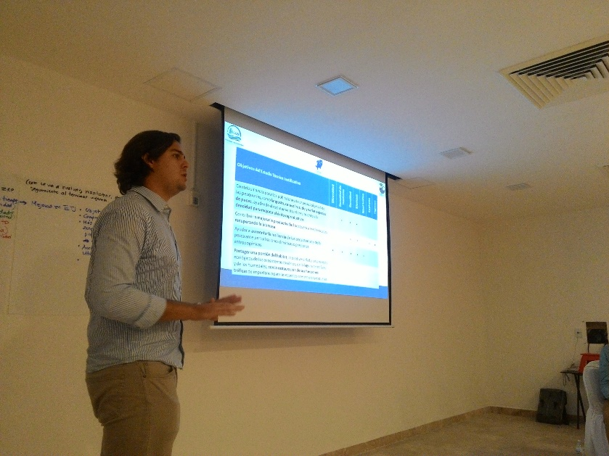
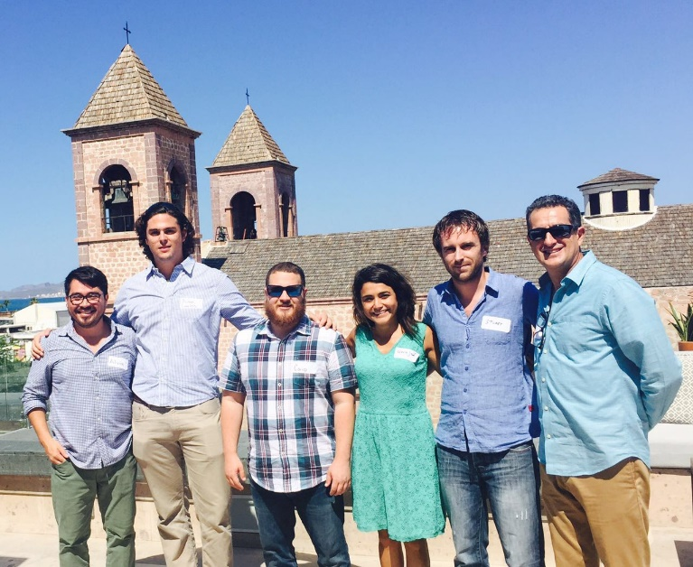
Summer and Fall Progress Outreach and Feedback
Outreach and Feedback
Workshop “ Evaluacion y Seguimiento de Zonas de Refugio en Mexico” – La Paz, Mexico.
Presentation of list of indicators and preliminary results from Quintana Roo.
Group activity to debate possible indicators in the evaluation of fishing refugees.

Slide 9
Next Steps – Fall Quarter
Field trip to Mexico
Guidebook outline
Shiny app (beta version)
Final Report outline

Slide 10
Questions?

Slide 11
Thank you!

